Slide 1
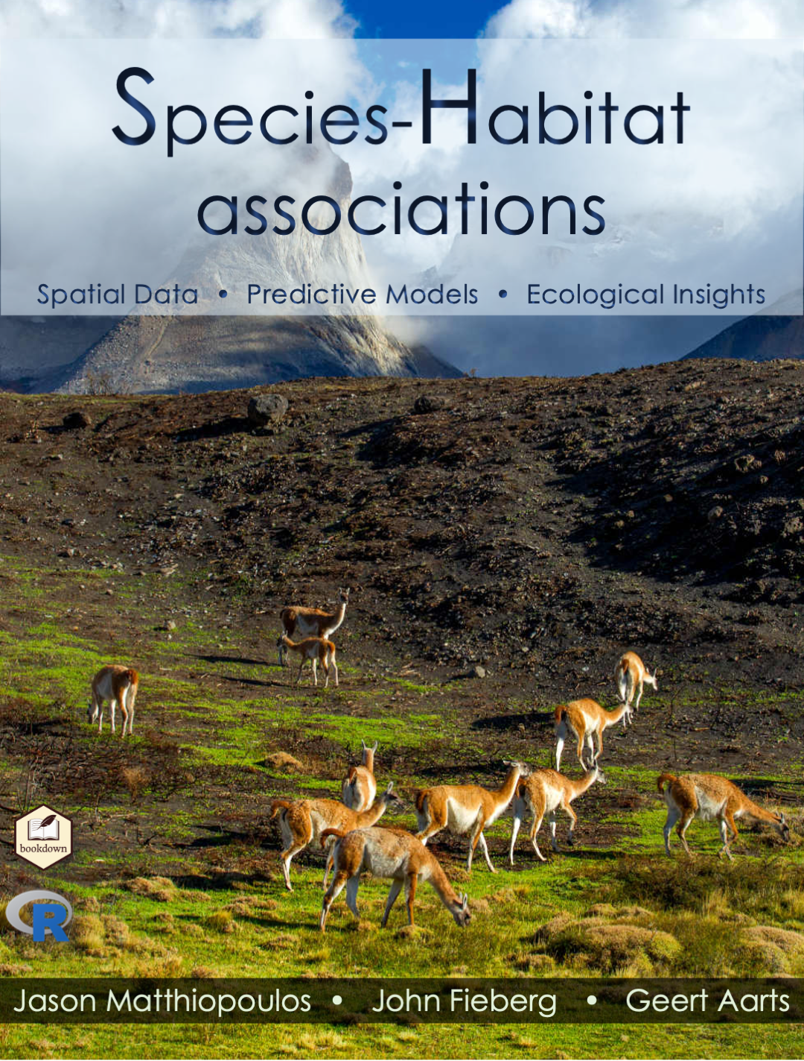

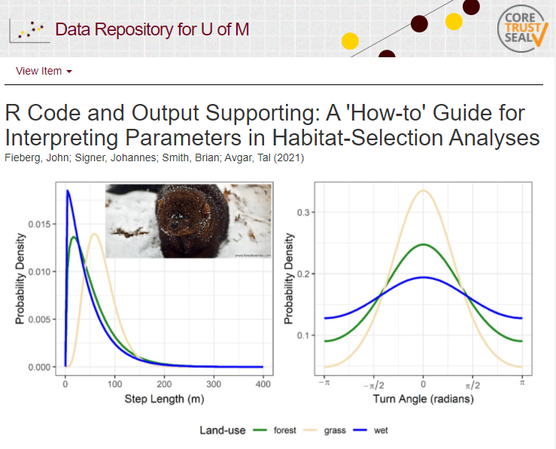
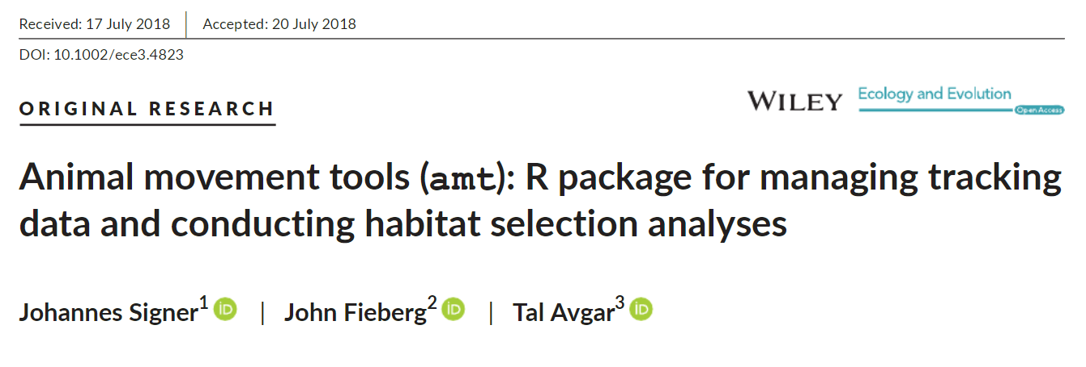
An Introduction to Resource and Step-Selection Functions
John Fieberg, Professor,
Department of Fisheries, Wildlife, and Conservation Biology

Slide 2
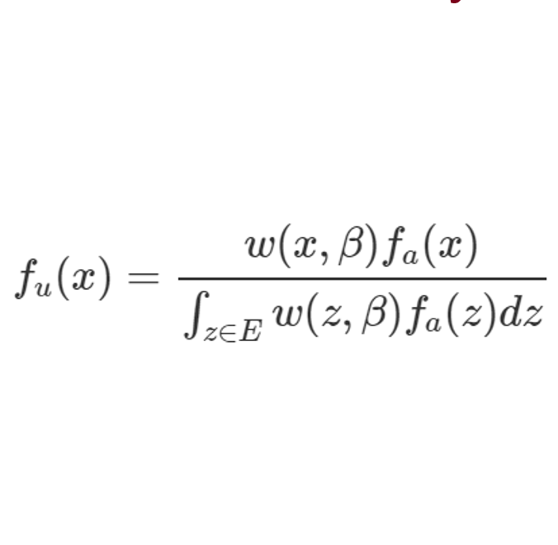
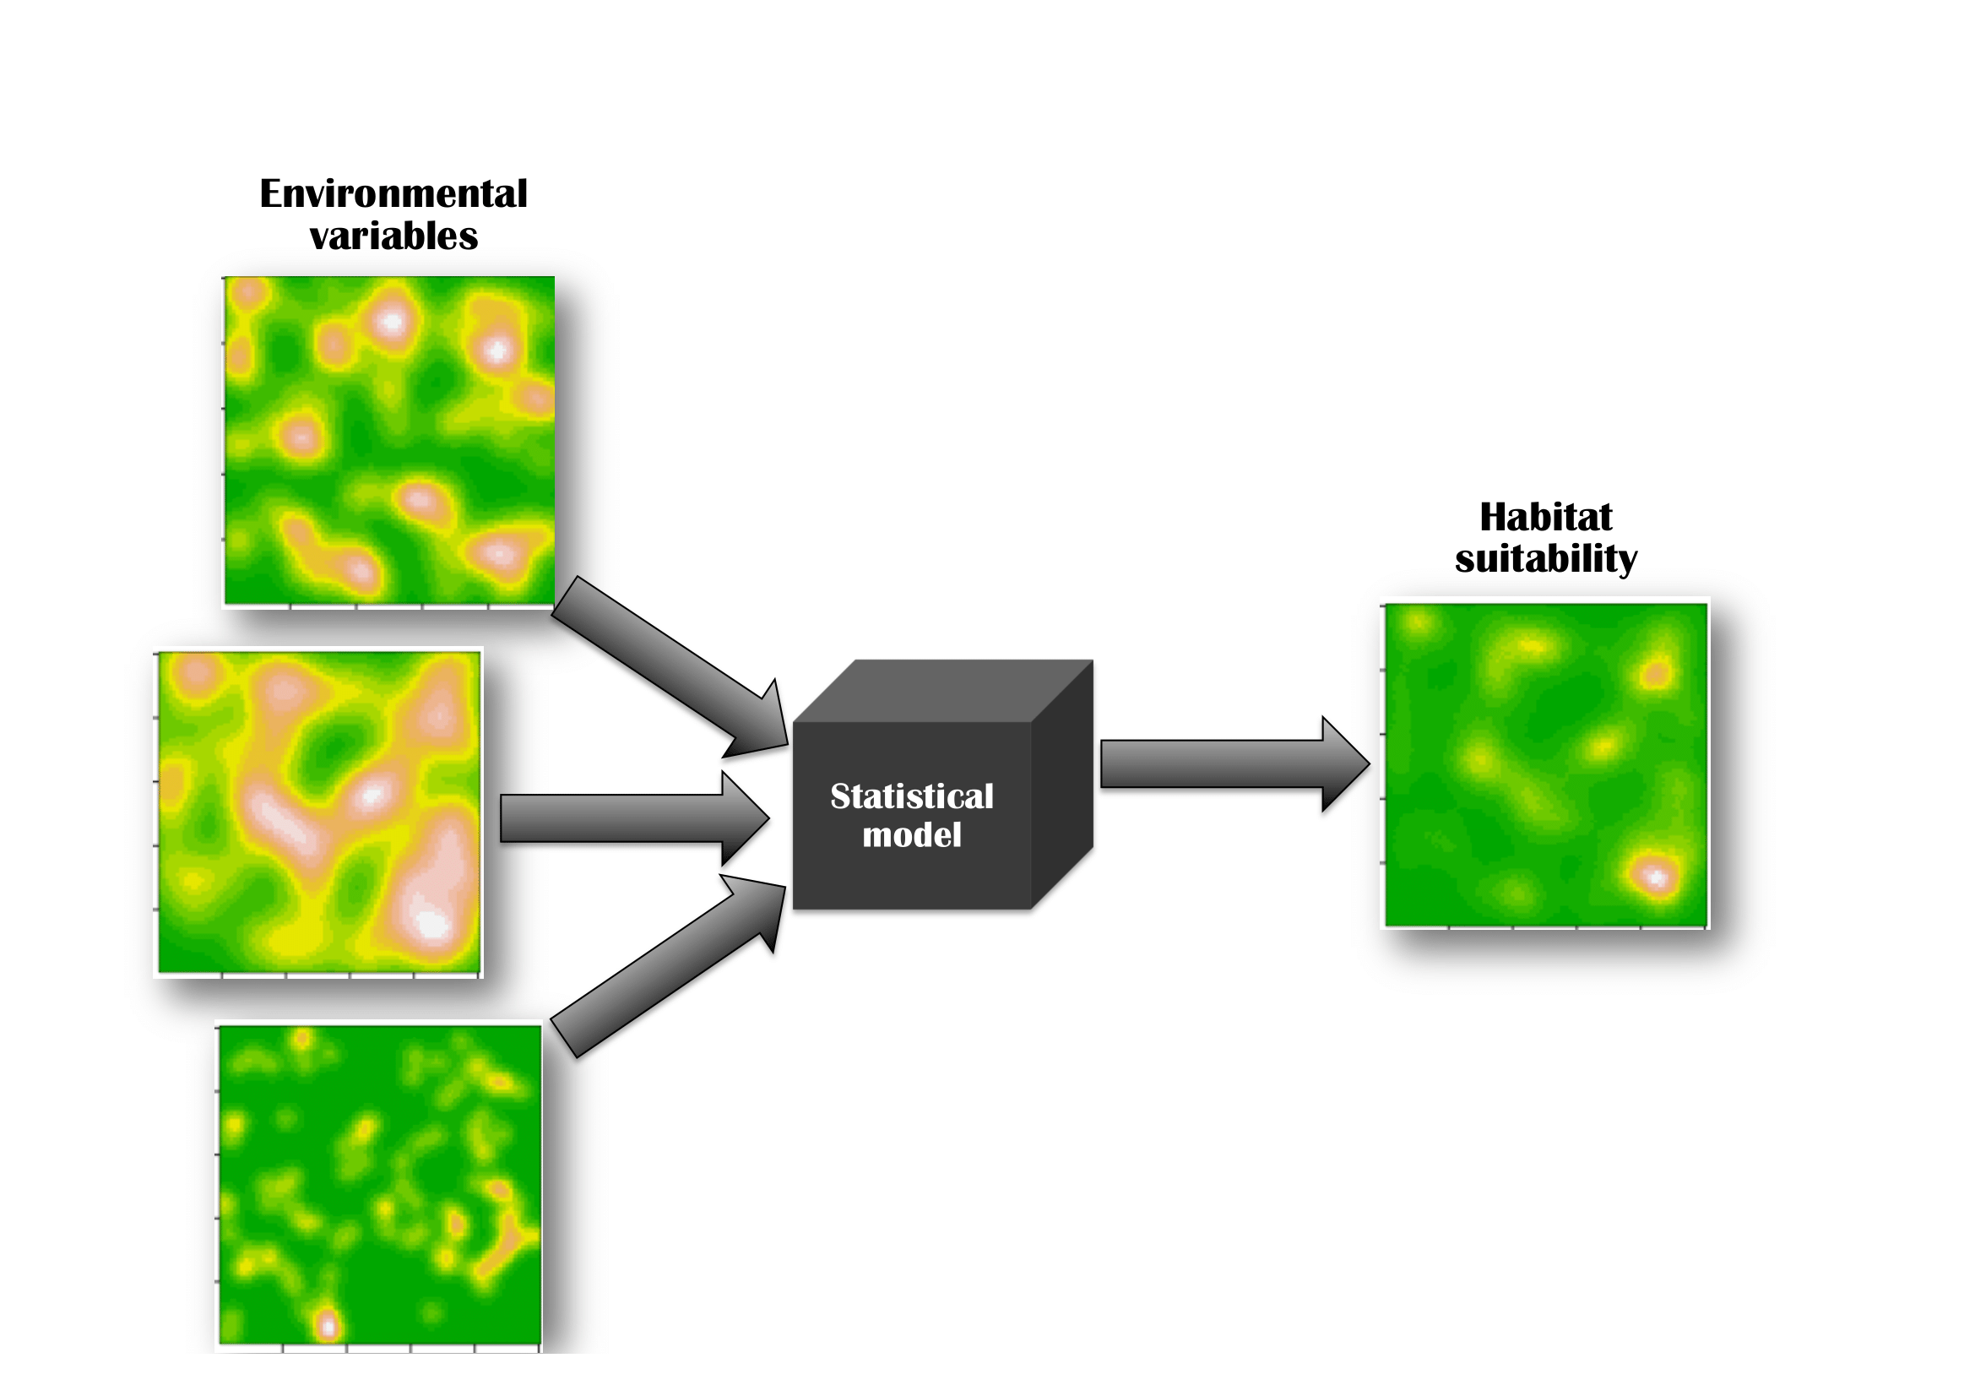
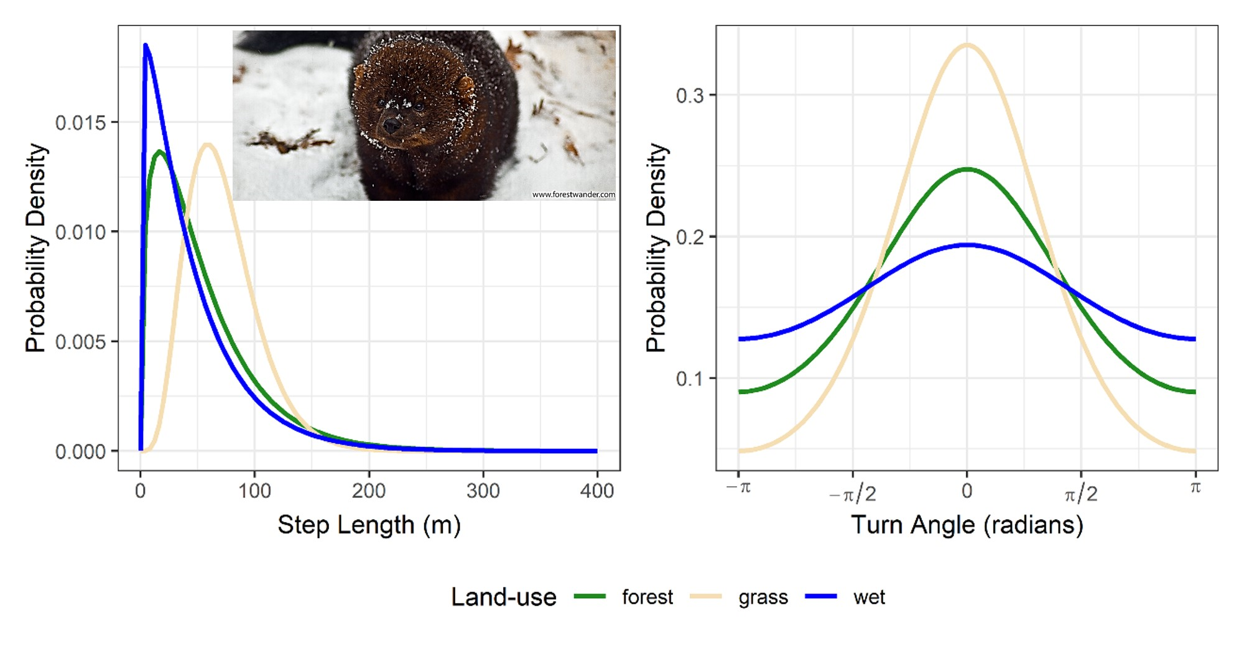
Outline
Species-Habitat-Association Models
Frameworks for Interpreting Parameters
Modeling Animal Movement
Species Distribution Models
Habitat-Selection Models
Inhomogeneous Spatial Point Process
Weighted Distribution Theory
Integrated Step-Selection Functions

Slide 3
Species-Habitat-Association Models
Link Species to their Environment
Where do species occur?
Why are there and where else they might be?
Applications
Designate protected areas
Estimate anthropogenic impacts
Assess risks from invasive species or disease transmission from wildlife to humans.

Slide 4

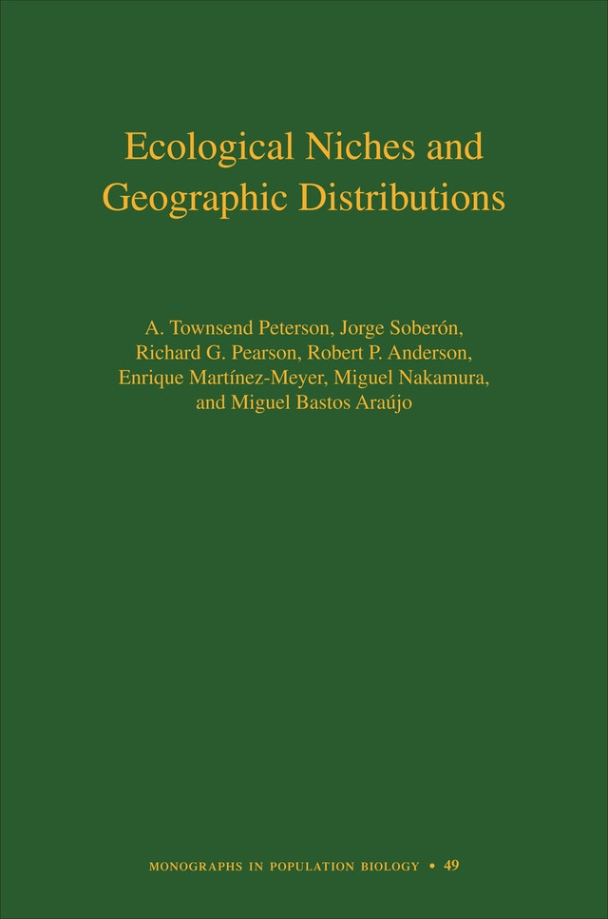
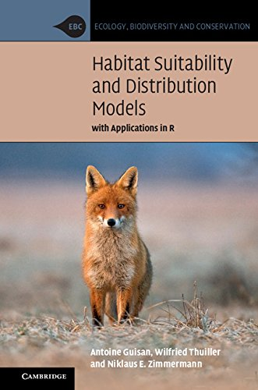
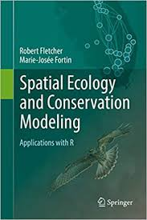
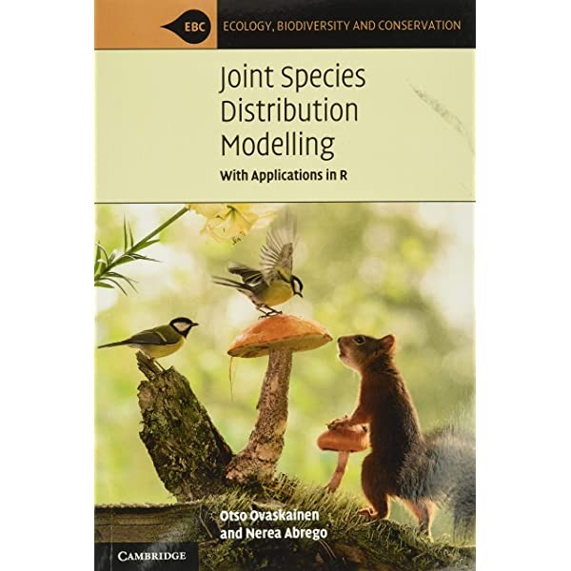
Species Distribution Models
‘ISI’s Essential Science Indicators identifies species distribution modeling as the top ranked research front in ecology and the environmental sciences.’ (Renner and Warton 2013)
Compare environments at observed and background/pseudo-absence locations
MaxEnt, Generalized linear models (GLMs), Generalized Additive Models (GAMs), Boosted regression trees
Different ways of modeling the distribution of locations as a function of spatial predictors (resources, risks, and conditions)

Slide 5
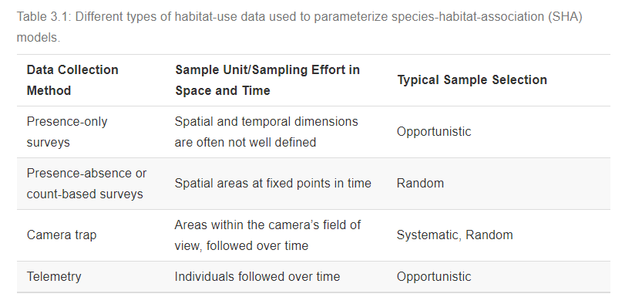

Slide 6

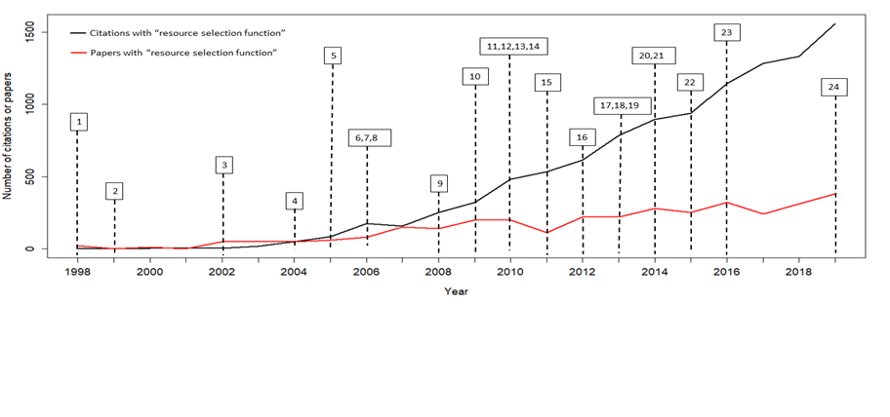
Habitat-Selection Models
Quantify habitat preference by comparing used and available habitat
Northup, J.M, E. Vander Wal, M. Bonar, J. Fieberg, M.P. Laforge, M. Leclerc, C.M. Prokopenko, and B. D. Gerber. 2022. Conceptual and methodological advances in habitat-selection modeling: guidelines for ecology and evolution. Ecological Applications 32(1), e02470.

Slide 7
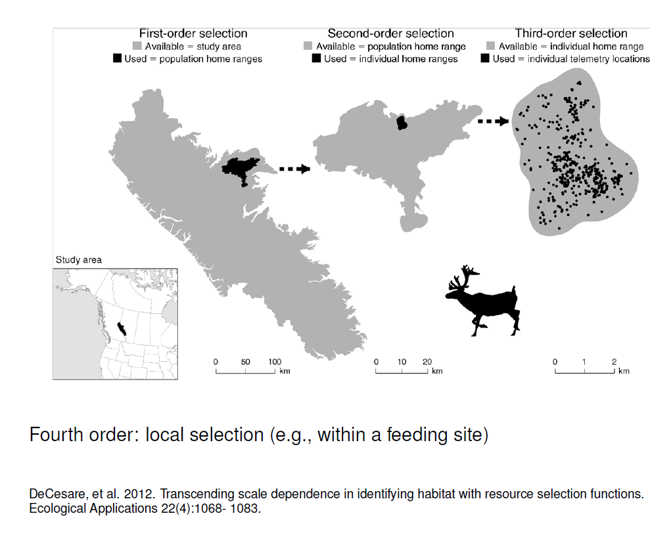
Johnson, D. 1980. The comparison of usage and availability
measurements for evaluating resource preference. Ecology 61:65-71.

Slide 8
Species Distribution and Habitat-Selection Models
Both compare:
Locations where individuals are found
Random/available/background/pseudo-absence locations
Model the distribution of locations as a function of:
Resources (more is better)
Risks (less is better)
Conditions (not too much or too little)

Slide 9
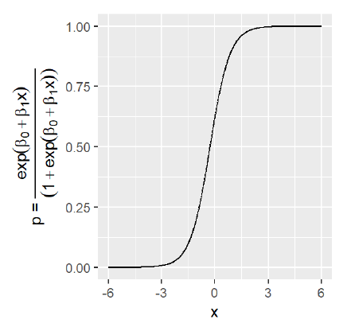
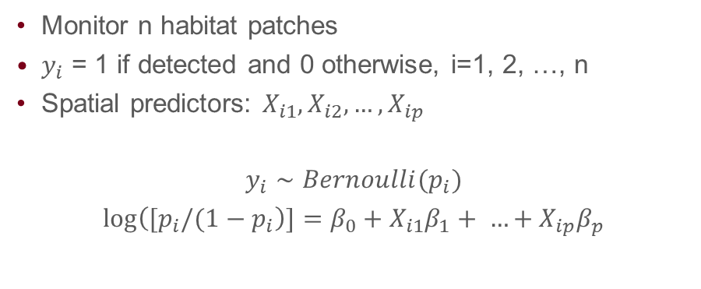

Logistic regression
Monitor n habitat patches
$y_{i}$ = 1 if detected and 0 otherwise, i=1, 2, …, n
Spatial predictors: $X_{i1},X_{i2}, …,X_{ip}$
$$y_{i}∼Bernoulli(p_{i})$$
$log\left([p_{i}/(1−p_{i}\right)]=β_{0}+X_{i1}β_{1}+ …+X_{ip}β_{p}$
$$p_{i}= \frac{exp\left(β_{0}+X_{i1}β_{1}+ …+X_{ip}β_{p}\right)}{1+exp\left(β_{0}+X_{i1}β_{1}+ …+X_{ip}β_{p}\right)}$$

Slide 10
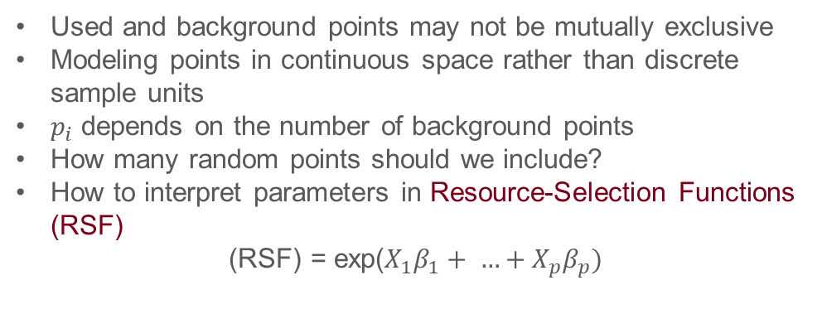
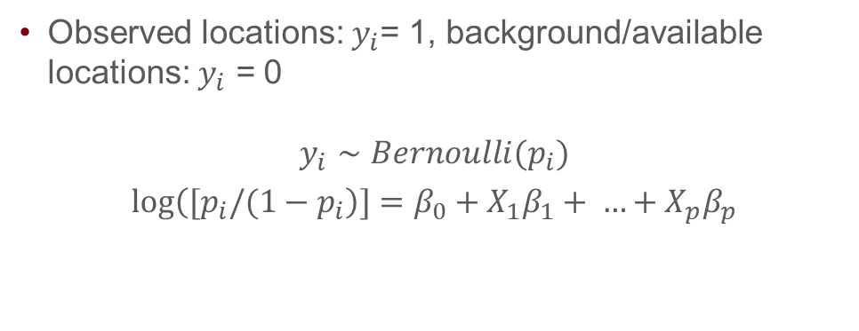
Resource-Selection Functions
Observed locations: $y_{i}$= 1, background/available locations: $y_{i}$ = 0
$$y_{i}∼Bernoulli(p_{i})$$
$log\left([p_{i}/(1−p_{i}\right)]=β_{0}+X_{1}β_{1}+ …+X_{p}β_{p}$
Used and background points may not be mutually exclusive
Modeling points in continuous space rather than discrete sample units
$p_{i}$ depends on the number of background points
How many random points should we include?
How to interpret parameters in Resource-Selection Functions (RSF)
(RSF) = exp($X_{1}β_{1}+ …+X_{p}β_{p})$

Slide 11
Traditionally, resource-selection functions were described as measuring “relative probabilities of use.”
Probability of using a site depends on the size of the site and how long individuals are monitored.
Probability of using a point in space = 0 (to ensure integration over space = 1 for continuous probability distributions).
Better to think of modeling hazards (rates of use), which can be integrated over time or space to estimate utilization distributions.

Slide 12
Outline
Species-Habitat-Association Models
Frameworks for Interpreting Parameters
Modeling Animal Movement
Species Distribution Models
Habitat-Selection Models
Inhomogeneous Spatial Point Process
Weighted Distribution Theory
Integrated Step-Selection Functions

Slide 13


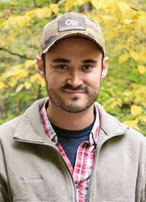
Frameworks for Interpreting Parameters
Johannes Signer, University of Goettingen, Germany
Tal Avgar, Utah State University
Brian Smith, Grad Student, Utah State University

Slide 14
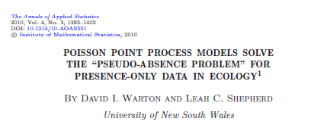
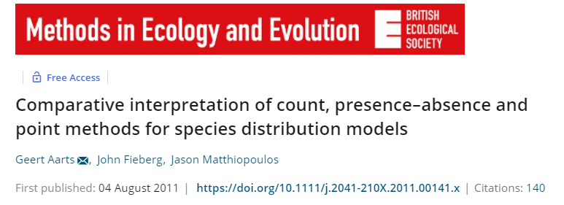
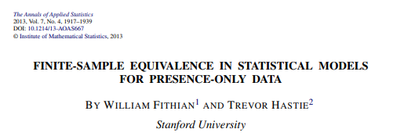


Slide 15
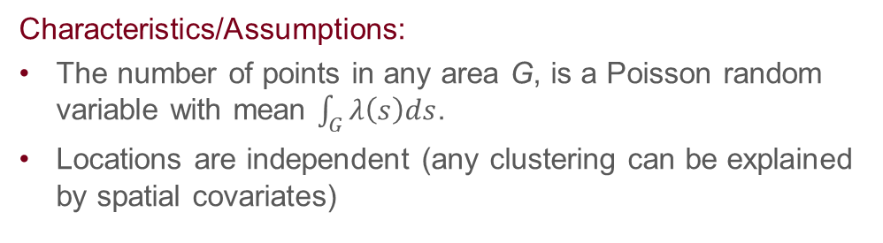
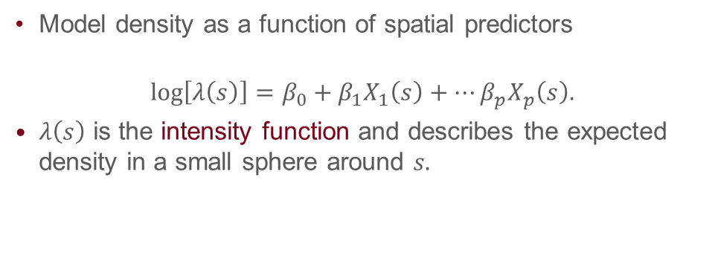
Inhomogeneous Poisson Point Process (IPP)
Model density as a function of spatial predictors
$$\log\left[λ\left(s\right)\right]=β_{0}+β_{1}X_{1}\left(s\right)+…β_{p}X_{p}\left(s\right).$$
$λ\left(s\right)$ is the intensity function and describes the expected density in a small sphere around $s.$
Characteristics/Assumptions:
The number of points in any area G, is a Poisson random variable with mean $\int_{G}{λ\left(s\right)ds}$.
Locations are independent (any clustering can be explained by spatial covariates)

Slide 16
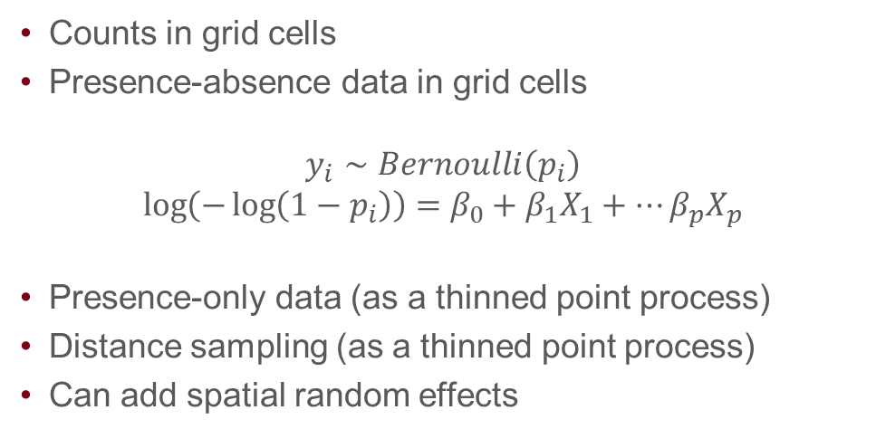
IPP as a Data Integrator
Counts in grid cells
Presence-absence data in grid cells
$$y_{i}∼Bernoulli\left(p_{i}\right)$$
$$\log\left(−\log\left(1−p_{i}\right)\right)=β_{0}+β_{1}X_{1}+…β_{p}X_{p}$$
Presence-only data (as a thinned point process)
Distance sampling (as a thinned point process)
Can add spatial random effects

Slide 17
Logistic Regression and IPP model
Logistic regression provides unbiased estimates of parameters in an Inhomogeneous point-process model:
as the number of available points increases to infinity (Warton and Shepherd 2010)
if we assign large (“infinite”) weights to the available points (Fithian and Hastie 2013)
in practice, we can assign large finite weights (e.g., 1000 or 5000 to available points, and a 1 to used points).
Warton, D.I. and Shepherd, L.C., 2010. Poisson point process models solve the “pseudo-absence problem” for presence-only data in ecology. The Annals of Applied Statistics, 4(3), pp.1383-1402.
Fithian, W. and T. Hastie (2013). Finite-sample equivalence in statistical models for presence-only data. Annals of Applied Statistics 7, 1917-1939.

Slide 18
Implementation
1. Observed locations (Y_{i} = 1)
2. Sample available locations (randomly, systematically) from an area A (e.g., the animal’s home range; set Y_{i} = 0).
3. Assign weights (1 to used points, and a large number – say 1000 - to available points)
4. Fit logistic regression model using the weights (throw away the intercept). 5. Increase the number of available points until slope parameters stabilize.

Slide 19
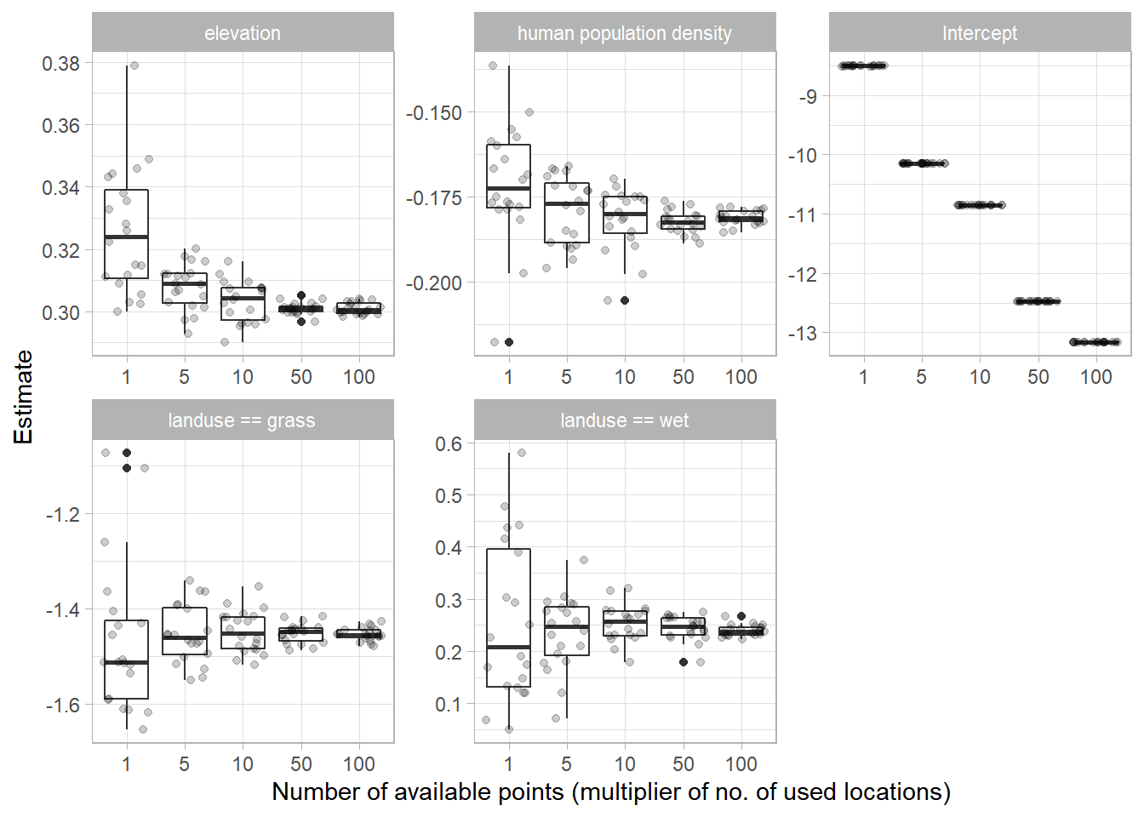
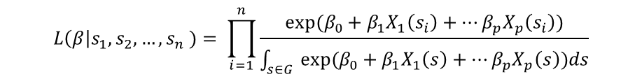
$$L\left(β\right|s_{1},s_{2}, …, s_{n} )= \prod_{i=1}^{n}{\frac{{exp⁡(β}_{0}+β_{1}X_{1}\left(s_{i}\right)+…β_{p}X_{p}\left(s_{i}\right))}{\int_{s∈G }{{exp⁡(β}_{0}+β_{1}X_{1}\left(s\right)+…β_{p}X_{p}\left(s\right))ds}}}$$
Notes:
The available points are used to estimate an integral in the denominator of the likelihood function.
Parameters can be interpreted under the IPP framework

Slide 20
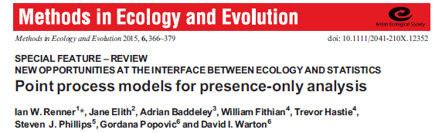
Does a Point Process Framework Make Sense for Telemetry Data?
Inhomogeneous Point Process Model
Telemetry Data
Useful for interpreting parameters:
Species Distribution Models
Resource-Selection Functions
Historical emphasis on behavior (selection of habitat)
Repeated observations on the same individuals
Temporal data dimension
Autocorrelation
Weighted Distribution Theory

Slide 21
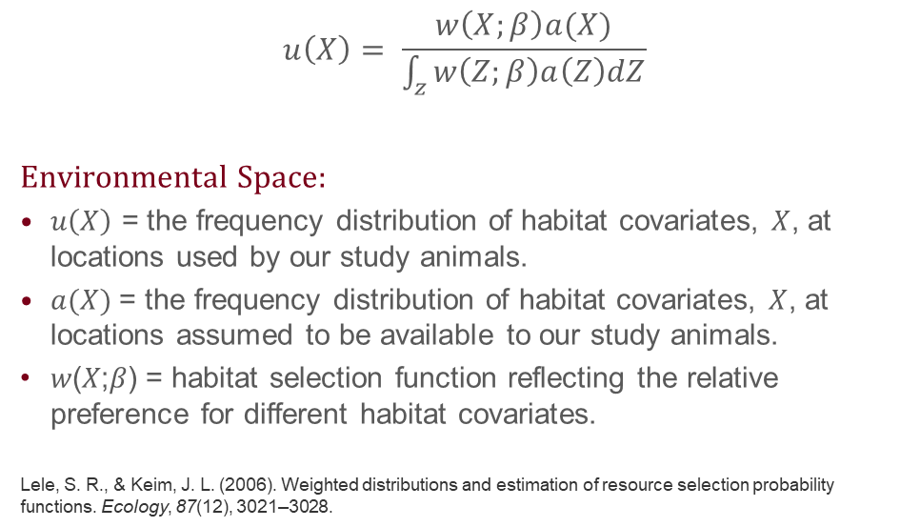
Weighted Distribution Theory
$$u\left(X\right)= \frac{w\left(X;β\right)a(X)}{\int_{z}{w\left(Z;β\right)a\left(Z\right)dZ}}$$
Environmental Space:
$u\left(X\right)$ = the frequency distribution of habitat covariates, $X$, at locations used by our study animals.
$a(X)$= the frequency distribution of habitat covariates, $X$, at locations assumed to be available to our study animals.
𝑤(𝑋;𝛽) = habitat selection function reflecting the relative preference for different habitat covariates.
Lele, S. R., & Keim, J. L. (2006). Weighted distributions and estimation of resource selection probability functions. Ecology, 87(12), 3021–3028.

Slide 22
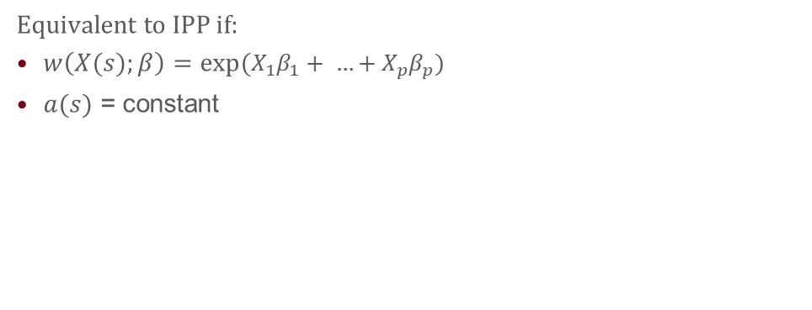
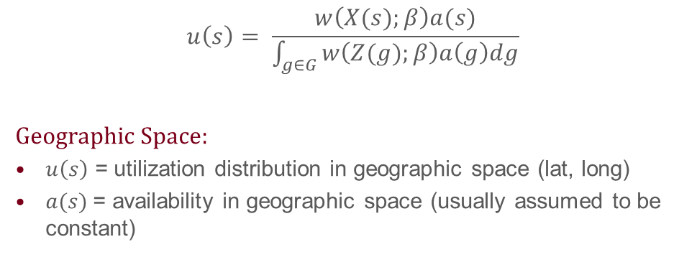
Weighted Distribution Theory
$$u\left(s\right)= \frac{w\left(X(s);β\right)a(s)}{\int_{g∈G}{w\left(Z(g);β\right)a\left(g\right)dg}}$$
Geographic Space:
$u\left(s\right)$ = utilization distribution in geographic space (lat, long)
$a(s)$= availability in geographic space (usually assumed to be constant)
Equivalent to IPP if:
$w\left(X(s);β\right)=exp⁡(X_{1}β_{1}+ …+X_{p}β_{p})$
$a(s)$ = constant

Slide 23
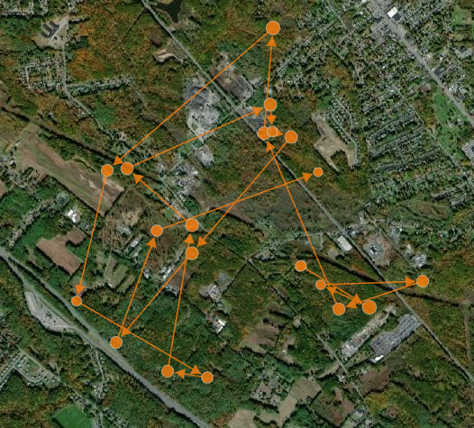
Exemplification
Logistic regression model with predictors:
Landcover class (forest, grass, wet)
Human Population Density
Elevation
Lupe, a fisher from Upstate NY (Lapoint et al. 2013)

Slide 24
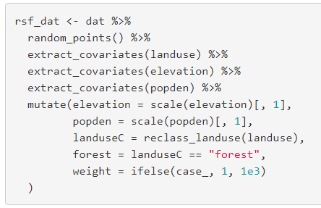
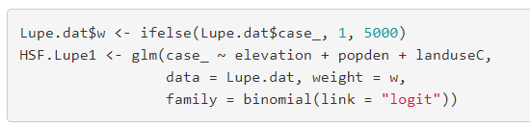
AppA_HSF_examples.Rmd (html)
To find out more!
?random_points

Slide 25
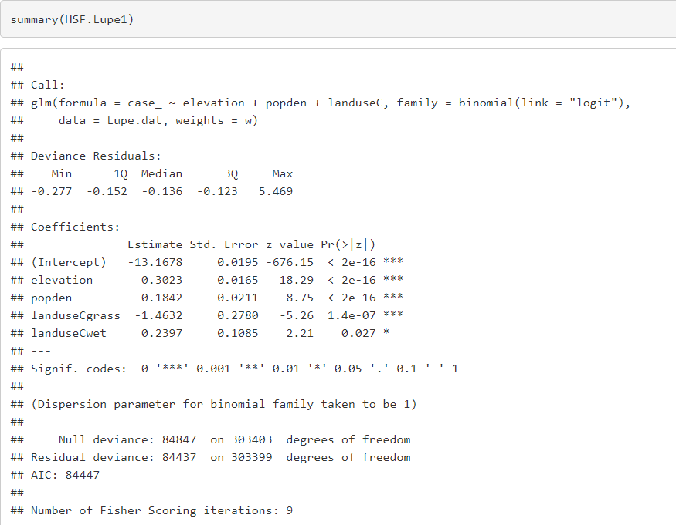
Think-pair-share: How do we interpret the coefficient for elevation?

Slide 26

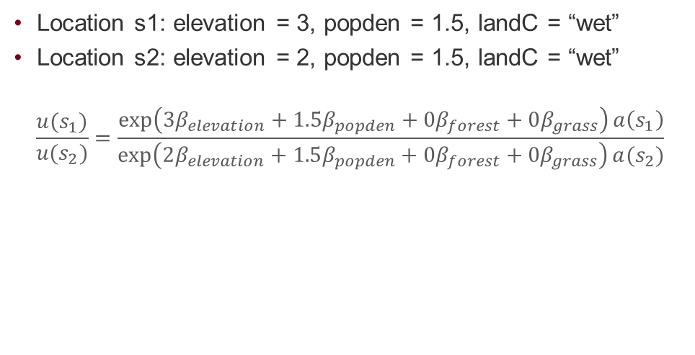
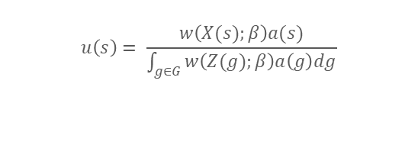

Relative probability of use
$$u\left(s\right)= \frac{w\left(X(s);β\right)a(s)}{\int_{g∈G}{w\left(Z(g);β\right)a\left(g\right)dg}}$$
Location s1: elevation = 3, popden = 1.5, landC = “wet”
Location s2: elevation = 2, popden = 1.5, landC = “wet”
$$\frac{u(s_{1})}{u(s_{2})}=\frac{\exp\left(3β_{elevation}+1.5β_{popden}+{0β}_{forest}+0β_{grass}\right)a\left(s_{1}\right)}{\exp\left(2β_{elevation}+1.5β_{popden}+{0β}_{forest}+0β_{grass}\right)a(s_{2})}$$
$$\frac{u(s_{1})}{u(s_{2})}=exp⁡(β_{elevation})\frac{a(s1)}{a(s_{2})}$$
If the two points are equally available, then
$\frac{u(s_{1})}{u(s_{2})}=exp(β_{elevation})$= 1.35
Lupe would be 1.35 times more likely to use/select the location with the higher elevation.

Slide 27
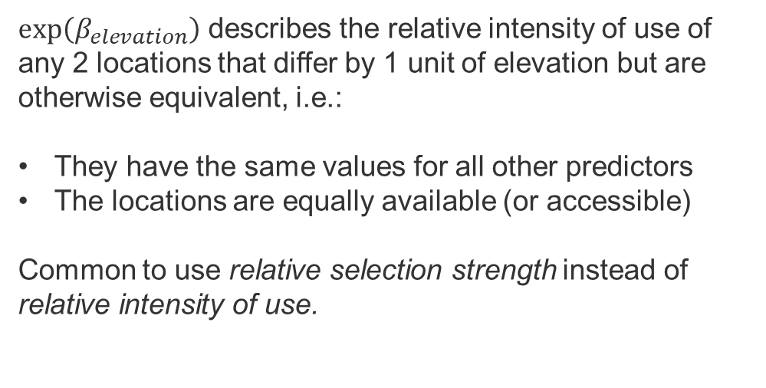
Quantitative Predictors
$exp\left(β_{elevation}\right)$ describes the relative intensity of use of any 2 locations that differ by 1 unit of elevation but are otherwise equivalent, i.e.:
They have the same values for all other predictors
The locations are equally available (or accessible)
Common to use relative selection strength instead of relative intensity of use.

Slide 28
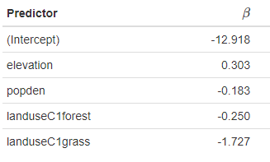
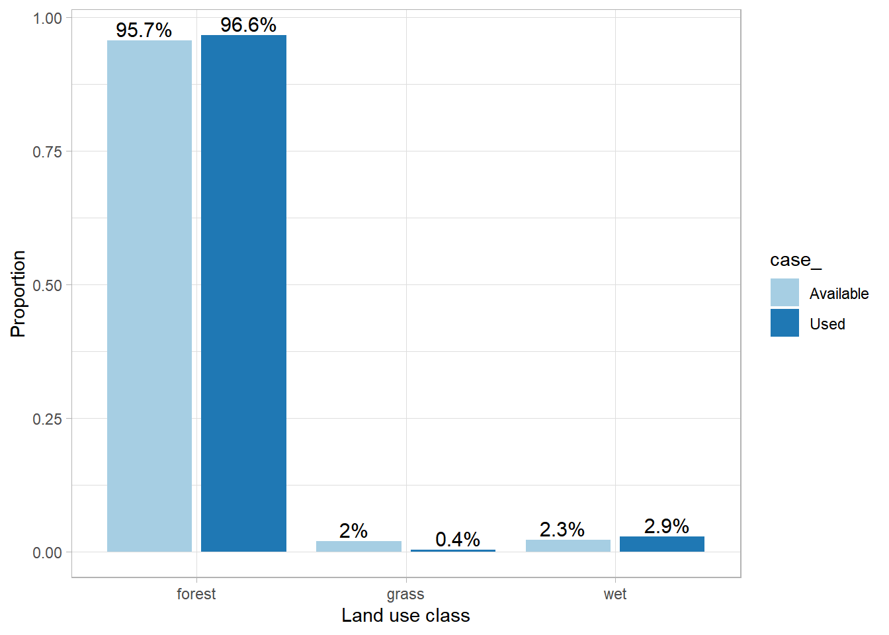
Parameters

Slide 29

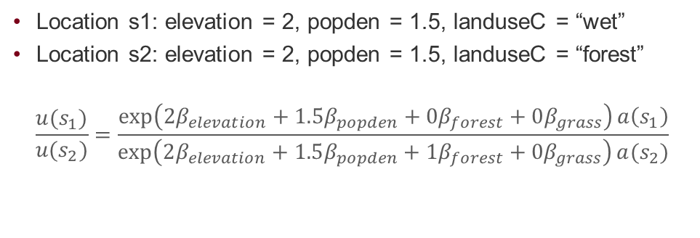

Categorical Predictors
Location s1: elevation = 2, popden = 1.5, landuseC = “wet”
Location s2: elevation = 2, popden = 1.5, landuseC = “forest”
$$\frac{u(s_{1})}{u(s_{2})}=\frac{\exp\left(2β_{elevation}+1.5β_{popden}+{0β}_{forest}+0β_{grass}\right)a\left(s_{1}\right)}{\exp\left(2β_{elevation}+1.5β_{popden}+{1β}_{forest}+0β_{grass}\right)a(s_{2})}$$
$$\frac{u(s_{1})}{u(s_{2})}=exp⁡({−β}_{forest})\frac{a(s1)}{a(s_{2})}$$
$$\frac{u(s_{1})}{u(s_{2})}=\exp\left({−β}_{forest}\right)=1.28$$
Given two equally available locations that differ only in landcover class, Lupe would be 1.28 times more likely to select the one in wet (versus forest).

Slide 30
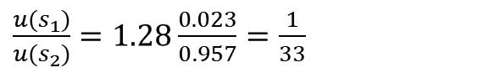
Categorical Predictors
$$\frac{u(s_{1})}{u(s_{2})}=exp⁡({−β}_{forest})\frac{a(s1)}{a(s_{2})}$$
$\frac{u(s_{1})}{u(s_{2})}=1.28$ $\frac{0.023}{0.957}=$ $\frac{1}{33}$
Suggests Lupe is 33 times more likely to be found in forest than wet
Assumes, naively, that forest and wet do not differ in terms of human population density and elevation

Slide 31
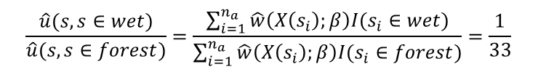
Integrated Spatial Intensities
$$\frac{u(s, s∈wet)}{u(s, s∈forest)}=\frac{\int_{G}{u\left(s\right)I\left(s∈wet\right)ds}}{\int_{G}{u\left(s\right)I\left(s∈forest\right)ds}}$$
$$\frac{\hat{u}(s, s∈wet)}{\hat{u}(s, s∈forest)}=\frac{\sum_{i=1}^{n_{a}}{\hat{w}\left(X\left(s_{i}\right);β\right)I(s_{i}∈wet)}}{\sum_{i=1}^{n_{a}}{\hat{w}\left(X\left(s_{i}\right);β\right)I(s_{i}∈forest)}}=\frac{1}{33}$$
Lupe is 33 times more likely to be found in forest versus wet areas.

Slide 32
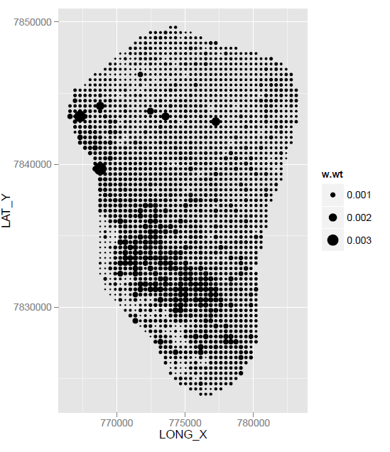
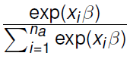
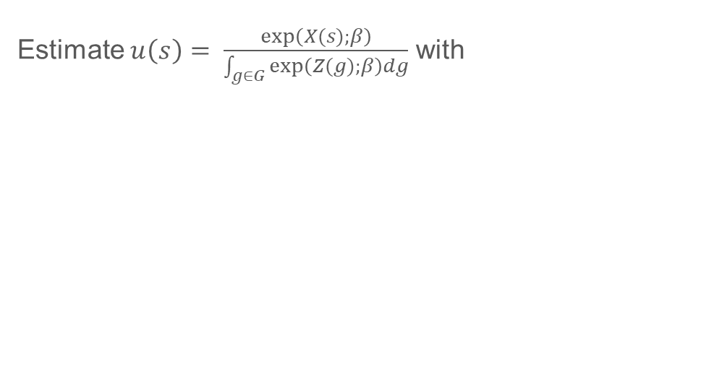
How to create a pretty map?
Estimate $u\left(s\right)= \frac{exp\left(X(s);β\right)}{\int_{g∈G}{exp\left(Z(g);β\right)dg}}$ with

Slide 33
Interpret parameters when allowing for non-linear relationships
Parameters in models with interactions

Slide 34
Telemetry data and independence
Point process models assume observations are independent, but…
Observations close in time are likely to also be close in space…
Historically, biologists would:
Sample less frequently or subsample data until location data are “independent”
Justify treating data as independent if an individual could have moved anywhere in its home range between sampling times (“biological independence”).

Slide 35

See Inês Silva’s talk tomorrow for how to:
Deal with autocorrelation/non-regular sampling
Estimate parameters of a Gaussian availability distribution

Slide 36
Outline
Species-Habitat-Association Models
Frameworks for Interpreting Parameters
Modeling Animal Movement
Species Distribution Models
Habitat-Selection Models
Inhomogeneous Spatial Point Process
Weighted Distribution Theory
Integrated Step-Selection Functions

Slide 37
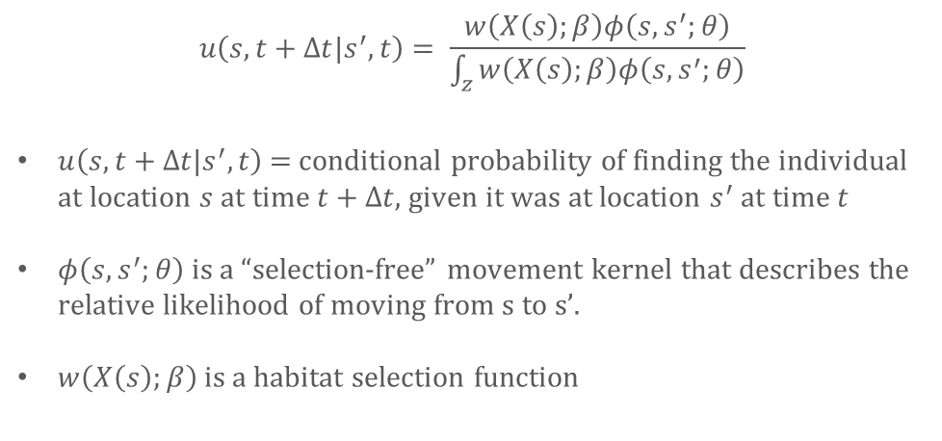
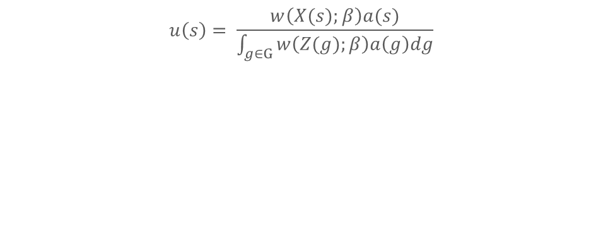
Step-Selection Analyses
$$u\left(s\right)= \frac{w\left(X(s);β\right)a(s)}{\int_{g∈G}{w\left(Z(g);β\right)a\left(g\right)dg}}$$
$$u\left(s, t+Δt|s^{′}, t\right)= \frac{w\left(X\left(s\right);β\right)φ\left(s,s^{′};θ\right)}{\int_{z}{w\left(X\left(s\right);β\right)φ\left(s,s^{′};θ\right)}}$$
$u\left(s, t+Δt|s^{′}, t\right)$ = conditional probability of finding the individual at location $s$ at time $t+Δt,$given it was at location $s^{′}$ at time $t$
$φ\left(s,s^{′};θ\right)$ is a “selection-free” movement kernel that describes the relative likelihood of moving from s to s’.
$w\left(X\left(s\right);β\right)$is a habitat selection function

Slide 38
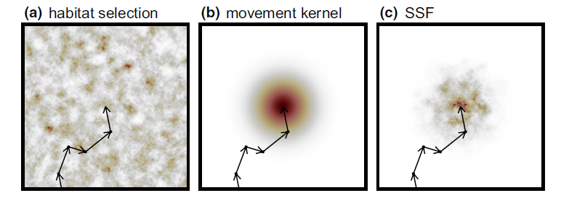
Michelot, T., Klappstein, N. J., Potts, J. R., & Fieberg, J. (2024). Understanding step selection analysis through numerical integration. Methods in Ecology and Evolution, 15(1), 24-35.

Slide 39
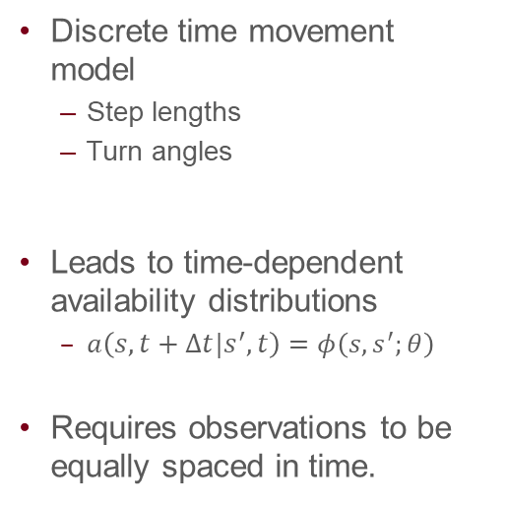

Models for $φ\left(s,s^{′};θ\right)$
Discrete time movement model
Step lengths
Turn angles
Leads to time-dependent availability distributions
$a\left(s, t+Δt|s^{′}, t\right)=φ\left(s,s^{′};θ\right)$
Requires observations to be equally spaced in time.
Thurfjell, H., Ciuti, S. and Boyce, M.S., 2014. Applications of step-selection functions in ecology and conservation. Movement ecology, 2(1), p.4.

Slide 40
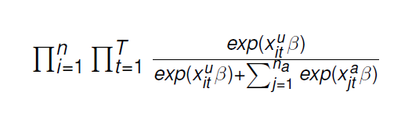

Conditional Logistic Regression
If we knew $φ\left(s,s^{′};θ\right)$, we could we could take a random sample of n_{a} points from this distribution and evaluate:
This is the same as the likelihood of a conditional logistic regression model.
We can fit using clogit function in R survival library: clogit(y x+ strata(strataID), data=)

Slide 41

Problem, we don’t know $φ\left(s,s^{′};θ\right)$
What can we do?
Resample observed step lengths and turn angles
Use step-lengths and turn angles to parameterize statistical distributions and sample from them
Or….give up on using conditional logistic regression.
Write functions to maximize the likelihood, which requires numerical integration to calculate integral in the denominator (Michelot et al. 2024).
Michelot, T., Klappstein, N. J., Potts, J. R., & Fieberg, J. (2024). Understanding step selection analysis through numerical integration. Methods in Ecology and Evolution, 15(1), 24-35.

Slide 42

Distributions
Step lengths are typically modeled using an exponential or gamma distribution (right skewed, continuous)
Turn angles are often assumed to be uniform or are modeled using a von Mises distribution

Slide 43

amt Package
The random_steps() function in the amt package
Uses maximum likelihood to fit gamma and von Mises distributions to step length and turn angles
Generates random steps, turn angles using the fitted distributions
Uses these to form random steps, and thus choose new available locations
Signer, J., Fieberg, J. and Avgar, T., 2019. Animal movement tools (amt): R package for managing tracking data and conducting habitat selection analyses. Ecology and Evolution, 9(2), pp.880-890.

Slide 44




Implementation
Estimate a tentative selection-free movement kernel, using observed step-lengths and turn angles, $\hat{φ}\left(s,s^{′};\hat{θ}\right)$
Generate time-dependent “available locations” (integration points) by simulating potential movements from the previously observed locations: $a\left(s, t+Δt|s^{′}, t\right)=\hat{φ}\left(s,s^{′};\hat{θ}\right)$
Estimate $β$ using conditional logistic regression, with strata formed by combining time-dependent used and available locations.

Slide 45

Potential problem
$$u\left(s, t+Δt|s^{′}, t\right)= \frac{w\left(X\left(s\right);β\right)φ\left(s,s^{′};θ\right)}{\int_{z}{w\left(X\left(s\right);β\right)φ\left(s,s^{′};θ\right)}}$$
$φ\left(s,s^{′};θ\right)$ is a “selection-free” movement kernel that describes the relative likelihood of moving from s to s’.
$w\left(X\left(s\right);β\right)$is referred to as a step-selection function

Slide 46
Problem and Potential Solution
Parameterizing the movement model without accounting for habitat selection can lead to biased estimates of movement parameters (Forester et al. 2009)
With certain statistical distributions, we can remove the bias by including movement characteristics (e.g., step length) associated with used and available points.
Similar to approximating the integral in the likelihood using “importance sampling” (Michelot et al. 2024)
Forester, J.D., Im, H.K. & Rathouz, P.J. (2009). Accounting for animal movement in estimation of resource selection functions: Sampling and data analysis. Ecology, 90, 3554–3565.
Michelot, T., Klappstein, N. J., Potts, J. R., & Fieberg, J. (2024). Understanding step selection analysis through numerical integration. Methods in Ecology and Evolution, 15(1), 24-35.

Slide 47

Implementation
Estimate a tentative selection-free movement kernel, using observed step-lengths and turn angles, $\hat{φ}\left(s,s^{′};\hat{θ}\right)$
Generate time-dependent “available locations” (integration points) by simulating potential movements from the previously observed locations: $a\left(s, t+Δt|s^{′}, t\right)=\hat{φ}\left(s,s^{′};\hat{θ}\right)$
Estimate $β$ using conditional logistic regression, with strata formed by combining time-dependent used and available locations.
Include movement characteristics (e.g., step-length, cos(turn angle)) as covariates to correct for bias due to two-step approach.
Re-estimate movement parameters in $\hat{φ}\left(s,s^{′};\hat{θ}\right)$using regression coefficients.

Slide 48


Integrated Step-Selection Analyses
Can model how movement is influenced by habitat (using interactions between movement characteristics and habitat).
For the mathematical details, see papers below and AppC_iSSA_movement.html from Fieberg et al. 2021.
Avgar, T., Potts, J.R., Lewis, M.A. & Boyce, M.S. (2016). Integrated step selection analysis: Bridging the gap between resource selection and animal movement. Methods Ecol. Evol., 7, 619–630.
Duchesne, T., Fortin, D. and Rivest, L.P. (2015) Equivalence between step selection functions and biased correlated random walks for statistical inference on animal movement. PloS one, 10, e0122947.

Slide 49


Slide 50
Some limitations (and possible solutions)
SSFs require observations equally spaced in time
Model 𝜙(𝑠,𝑠′;𝜃) as a function of Δ𝑡 or use a continuous-time model.
Multiple imputation (but see Hofmann, D. D., Cozzi, G., & Fieberg, J. (2024). Methods for implementing integrated step-selection functions with incomplete data. Movement Ecology, 12(1), 37).
Measurement error is often substantial
Model it: Brost, B. M., Hooten, M. B., Hanks, E. M., & Small, R. J. (2015). Animal movement constraints improve resource selection inference in the presence of telemetry error.
Estimate/adjust for its effect on parameters of interest: SIMEX (Clara Panchaud, MS thesis)

Slide 51
Some limitations (and possible solutions)
Steps are not independent:
Use robust SE’s (Prima, M. C., Duchesne, T., & Fortin, D. (2017). Robust inference from conditional logistic regression applied to movement and habitat selection analysis. PLoS One, 12(1), e0169779)
Step lengths and turn angles are not independent
Model dependence using copulae (Hodel, F. H., & Fieberg, J. R. (2022). Circular–linear copulae for animal movement data. Methods in Ecology and Evolution, 13(5), 1001-1013.)
Or, use a hidden Markov models to allow for state-switching SSFs
Klappstein, N. J., Thomas, L., & Michelot, T. (2023). Flexible hidden Markov models for behaviour-dependent habitat selection. Movement Ecology, 11(1), 30.
Pohle, J., Signer, J., Eccard, J. A., Dammhahn, M., & Schlägel, U. E. (2024). How to account for behavioral states in step-selection analysis: a model comparison. PeerJ, 12, e16509.

Slide 52
Some limitations (and possible solutions)
Movements are in 3-D
Incorporate depth as a predictor
Adapt 𝜙(𝑠,𝑠′;𝜃) to model movements in 3-D (Klappstein et al. in progress)

Slide 54


Statistical dependence
Fleming, C. H., Calabrese, J. M., Mueller, T., Olson, K. A., Leimgruber, P., & Fagan, W. F. (2014). From fine-scale foraging to home ranges: a semivariance approach to identifying movement modes across spatiotemporal scales. The American Naturalist, 183(5), E154-E167.
Notes:
Semi-variance = ½ variance of the differences between all points lag units apart

